Slide 1
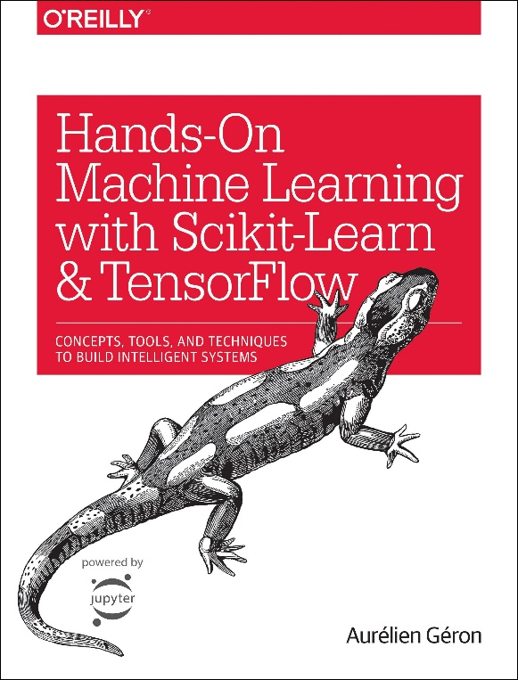

Novice Machine Learning E2E Project
Part 03
Split the Data
Mukunthan Ragavan

Slide 2
E2E Machine Learning Project
Look at the Big picture.
Get the Data (Split the Data).
Discover and visualize the data to get insights.
Prepare the data for ML algorithms.
Select a model to train it.
Fine-tune your model.
Present your solution.
Launch, monitor and maintain your system.

Slide 3
Split the Data! Why? To find generalization error which tells you how well your model will perform on instances it has never seen before. If the training error is low (i.e., your model makes few mistakes on the training set) but the generalization error is high, it means that your model is over fitting the training data.

Slide 4
Thanks All for watching and your subscription !

